Slide 1
Balloon Catheter Inspection Equipment
Anthony Peters, Shane Pooler, Ryan Stevenson, Kevin White

Slide 2
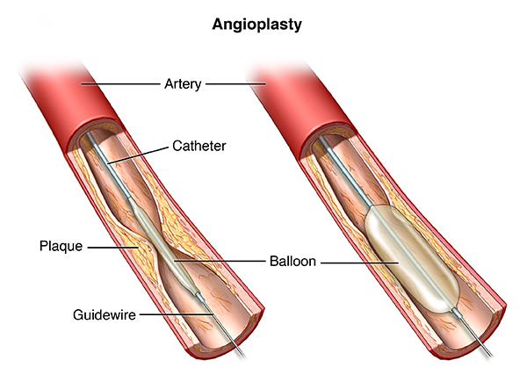
Introduction
Balloon catheters are used to open narrowed arteries and vessels within the body
Inserted onto the tip of a catheter and inflated at blockage site to flatten or compress plaque against artery or vessel wall
Common materials used today for balloon catheters are polyethylene terephthalate (PET) and nylon
Manufacturing process for catheter balloons:
Extrusion of raw materials to form a long tube
Balloon is formed through blow molding
Undergo inspection visually and by equipment for quality control purposes
Packaged for shipping
Figure 1-Balloon catheter inflated in an artery.
White POBA
Slide 2
Notes:
Initial clogging of arteries or vessels is called stenosis, which is when plaque builds up narrowing the wall of the particular artery or vessel. This can lead to loss of blow flow leading to major problems.

Slide 3
Introduction (cont.)
Sponsor for project: POBA medical
Located in Flagstaff, AZ
Manufacture custom sized balloons for different applications
Applications for POBA’s catheter balloons include:
Heart
Open narrowed arteries to prevent blood loss leading to the heart
Brain
Open narrowed carotid arteries to prevent blood loss to the brain
Drug Delivery
Drug release during inflation to reduce restenosis
Price per balloon range from $9 to $35
Cost per balloon is determined by production time, material, and size of balloon
White
POBA
Slide 3
Notes:
Actual material cost - $.5 to $1

Slide 4
Background
Purpose of this project was to design an automated balloon catheter inspection equipment for POBA Medical
POBA medical currently utilizes a manual inspection equipment
1-2 minute inspection time per balloon
An automated inspection equipment will enable POBA to inspect catheter balloons quick and efficiently compared to manual inspection process
20 second inspection time per balloon
Each balloon must meet dimensional and mechanical characteristics before introducing for medical purposes
White
POBA
Slide 4

Slide 5
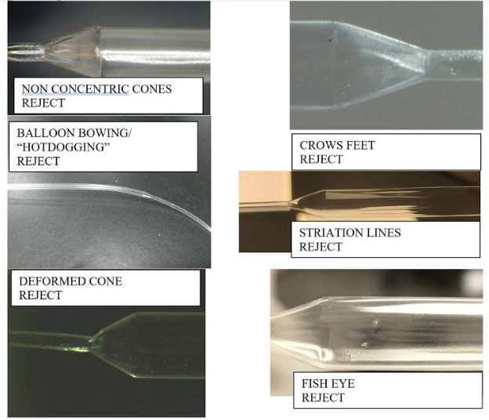
Project Requirements
Measure balloon diameters ranging from 1.25 - 45mm and balloon lengths ranging from 50 - 325mm
Rotational and longitudinal movement for inspection
Inflation for inspection
Equipment must be able to sit on table and transportable
Cost effective
Inspection time under a minute
Figure 2-Catheter balloon defects.
Stevenson
POBA
Slide 5
Figure 3-Catheter balloon dimensions.
Notes:
Briefly explain how our project requirements were adjusted. No cs or ee majors means we weren’t capable of creating software to detect anything

Slide 6
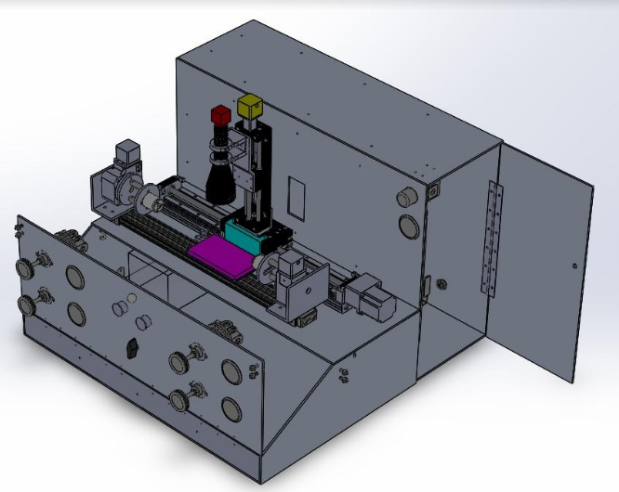
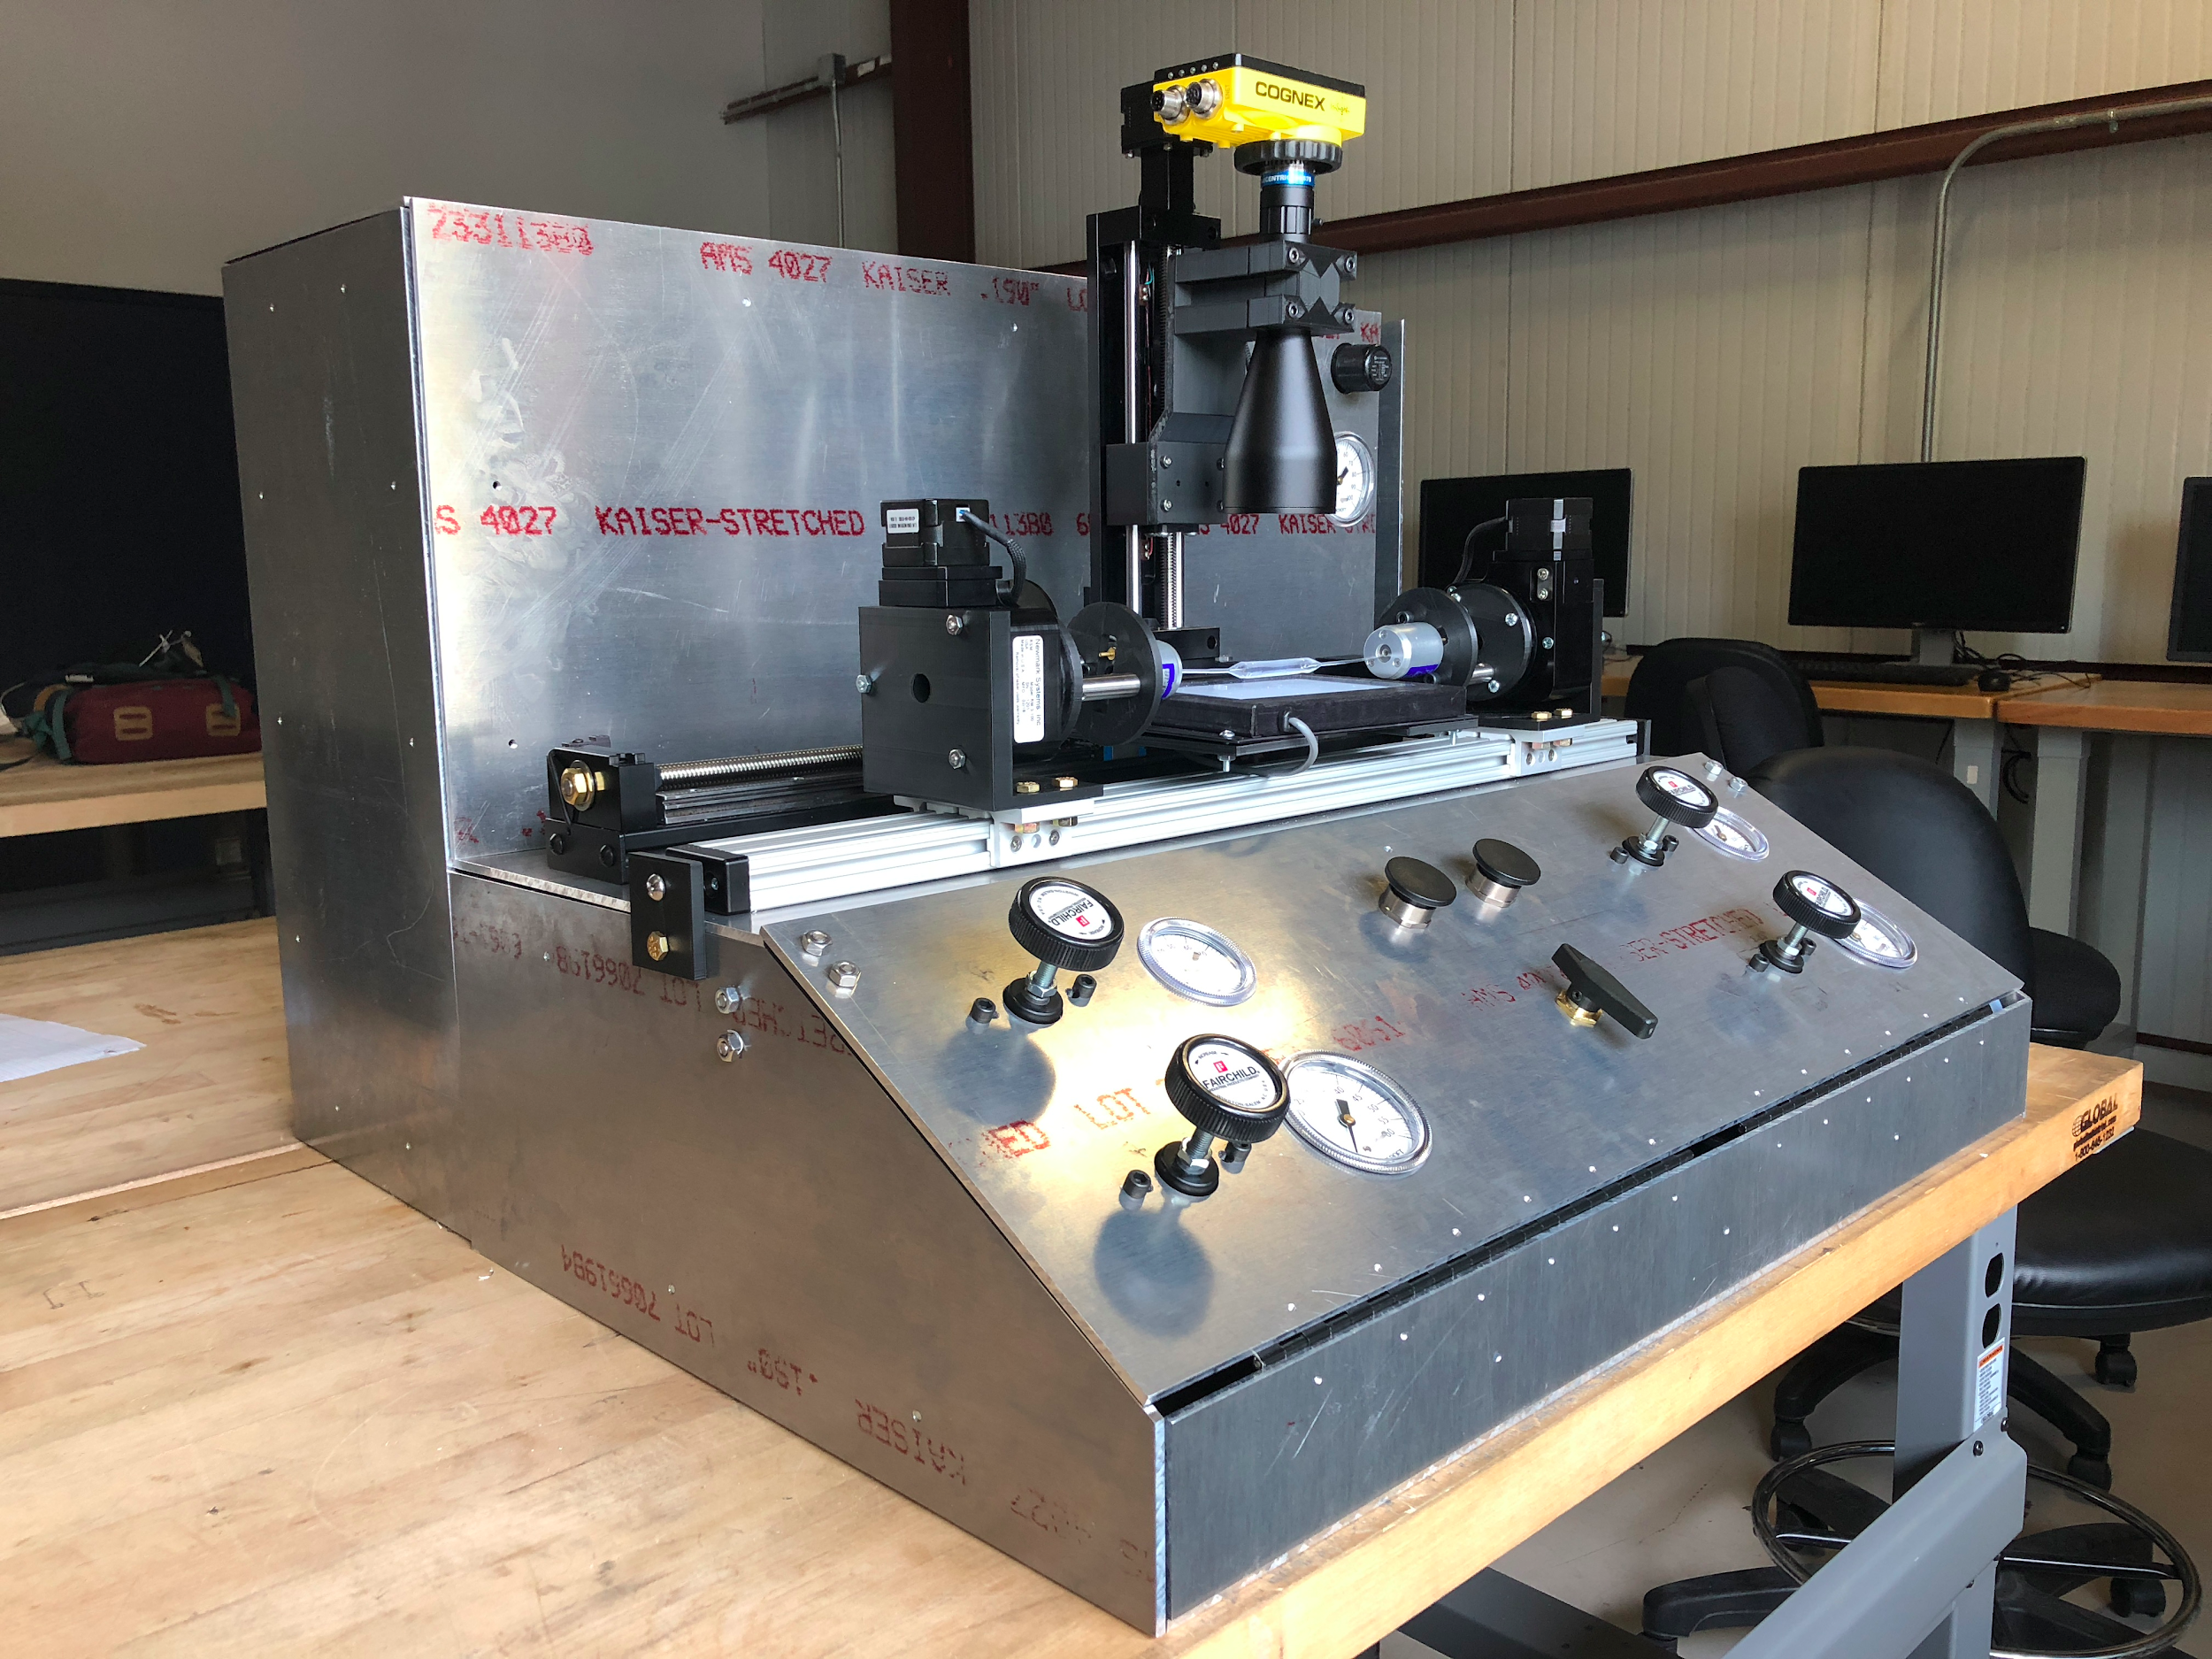
Design Solution
Figure 4-Solidworks Model
Figure 5-Assembled Balloon Catheter Inspection Equipment
Stevenson
POBA
Slide 6
Notes:
This is how we modeled the design. We built up. Label this stuff.

Slide 7
Manufacturing
Material: Aluminum 6061-T6
High strength
Low weight
Ease of machinability
We chose brackets instead of welding so that it can be disassembled.
In total this machine is 2.5 feet long and under 2 feet tall.
Figure 6-Assembled Balloon Catheter Inspection Equipment
Stevenson
POBA
Slide 7

Slide 8
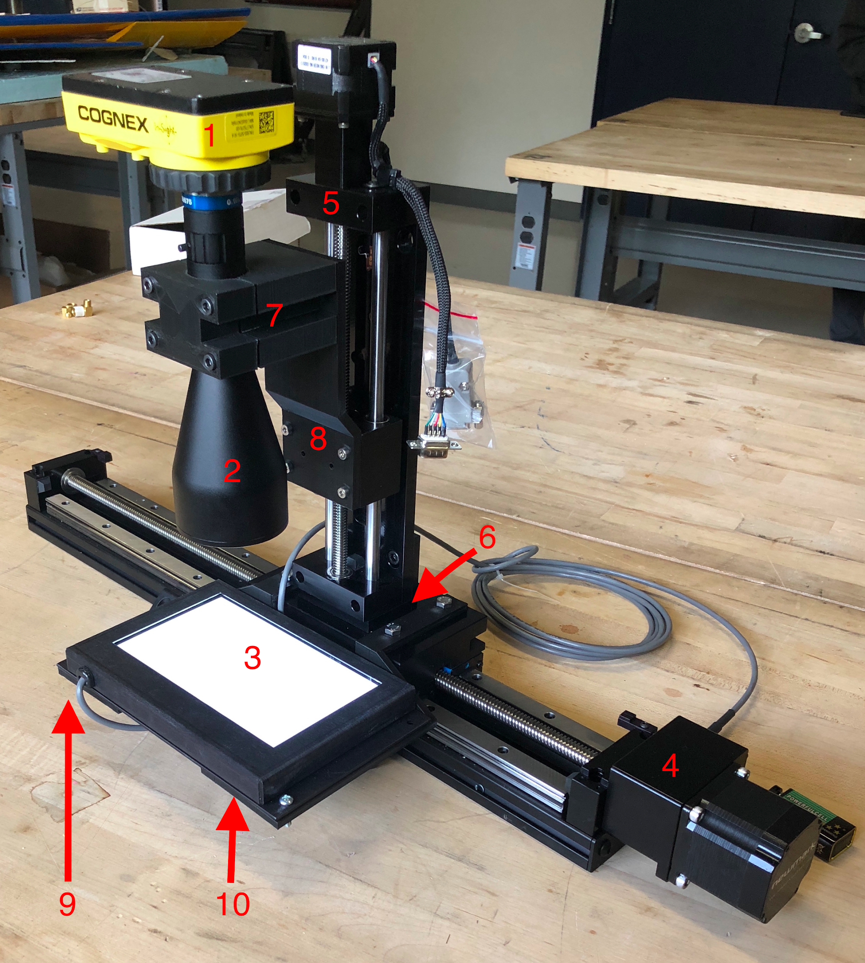
Camera System
Table 1- Camera System Main Components
Vendor | Part | Location # | Quantity
Cognex | Camera | 1 | 1
Edmund Optics | Lens | 2 | 1
Newmark | Horizontal Stage | 4 | 1
Newmark | Vertical Stage | 5 | 1
Newmark | L-Bracket | 6 | 1
Edmund Optics | Backlight | 3 | 1
POBA Medical | 3D Printed Lens Mount | 7 & 8 | 1
POBA Medical | 3D Printed Backlight Brackets | 9 & 10 | 1
Figure 7-Assembled Vision System
Pooler
POBA Slide 8
Notes:
Here is the camera subsystem of our device. This sub system includes a cognex camera, an edmund optics lens, a horizontal and vertical Newmark stage, a backlight, 3D printed lens mount, and 3D printed brackets to attach the backlight to the horizontal linear stage. To the left you will see the part name followed by its assembly location in the figure to the right. For clarification a “stage” is simply a stepper motor attached to a lead screw that moves a platform linearly. During operation, the camera, lens, and backlight all move in unison along the length of the linear stage and the vertical stage allows for coarse adjustment.

Slide 9
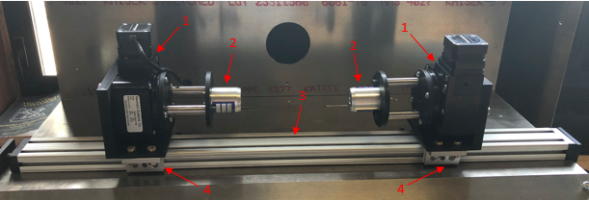
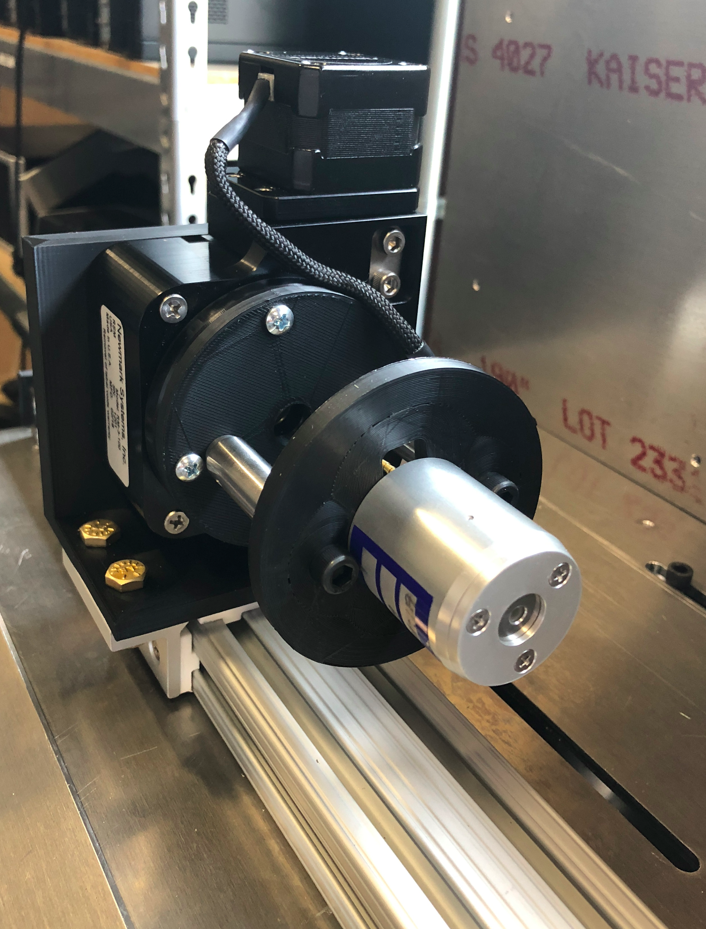
Rotary System
Table 2-Rotary System Main Components
Figure 8-Assembled Rotary System
Vendor | Part | Location # | Quantity
Newmark Systems | RM-3 Rotary Stage | 1 | 2
Blockwise | CCB Tube Grabber | 2 | 2
McMaster | 29 inch slide | 3 | 1
McMaster | Carriage mount | 4 | 2
Figure 9-Front view of Rotary System.
White
POBA
Slide 9
Notes:
*add in #’s for 3d printed mounts

Slide 10
Air System
Regulator
High
Gauge
Balloon
Tank
Buttons for bladder
Low
Peters
POBA
Slide 10

Slide 11
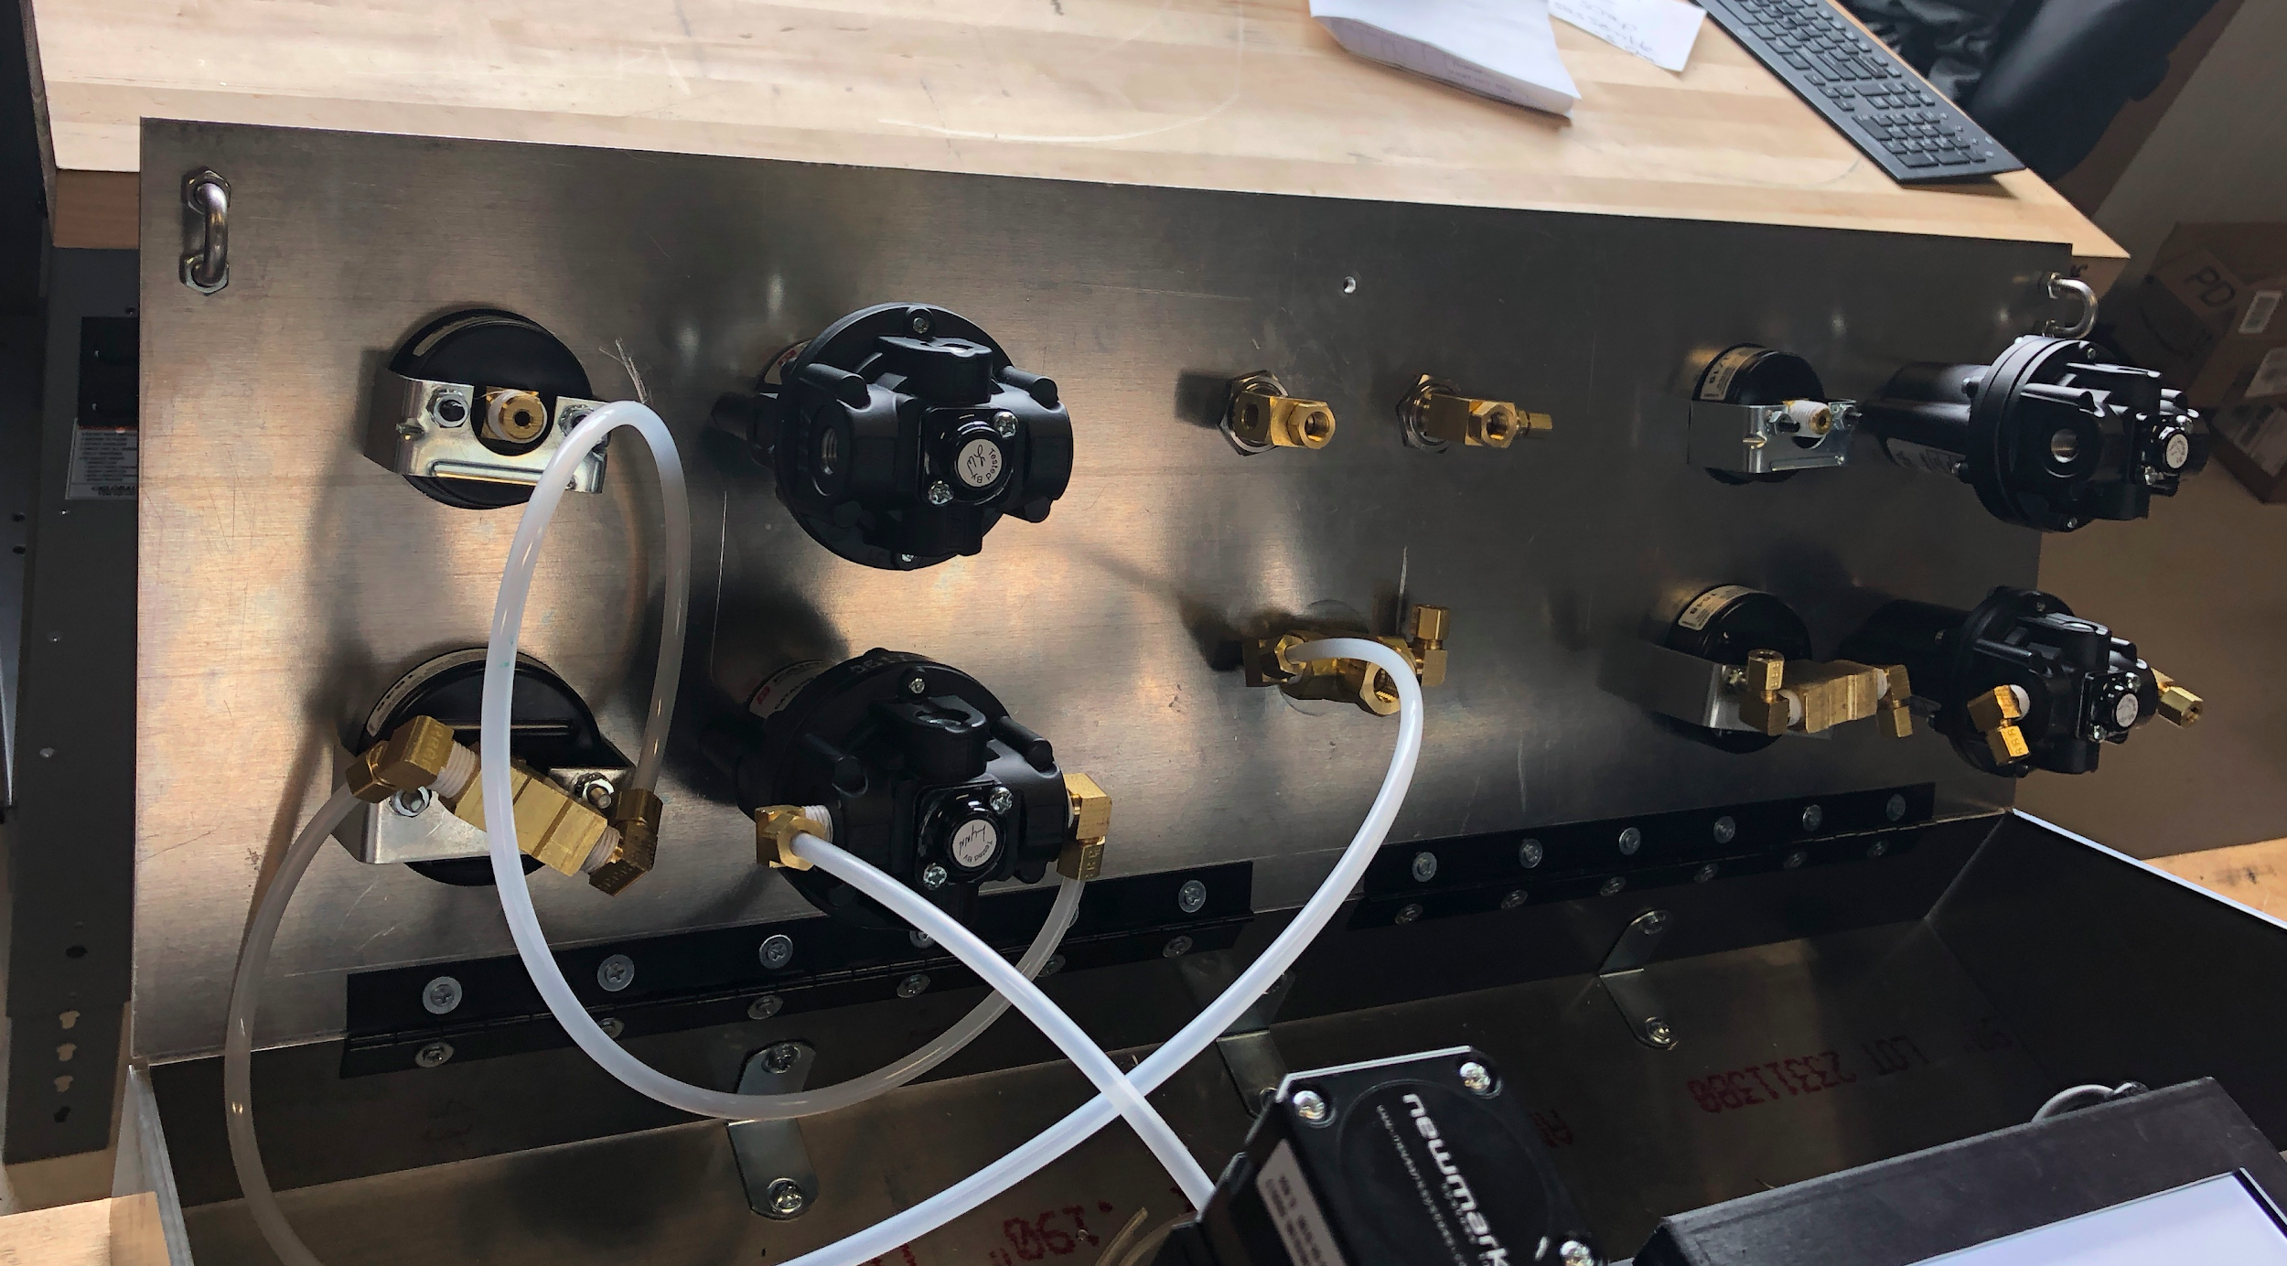
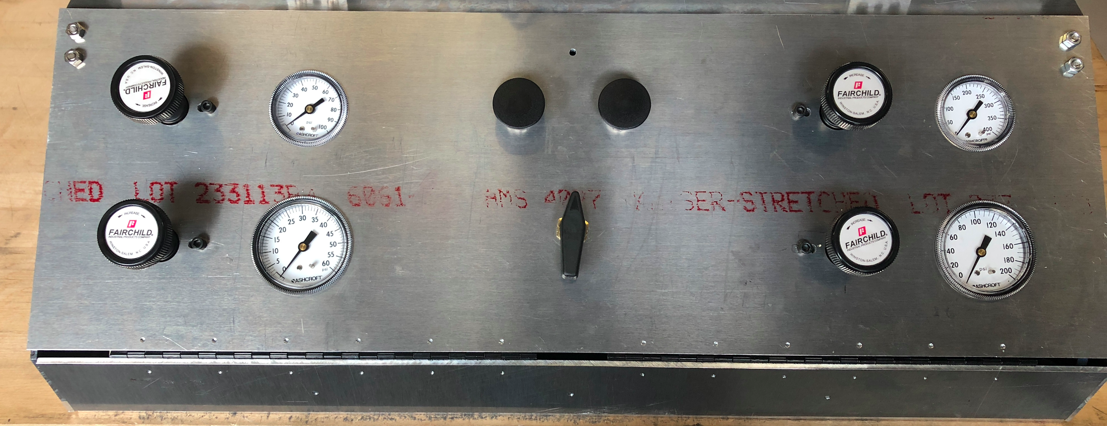
Air System
Figure 10 (left): back panel side of air system
The panel swings open for ease of access to pressure regulators and gauges.
Figure 11 (Bottom): Front panel side of air system
The buttons on the top open and close the bladder to install the balloon. The knob on the bottom switches the air pressure from Low to High.
Peters
POBA
Slide 11

Slide 12
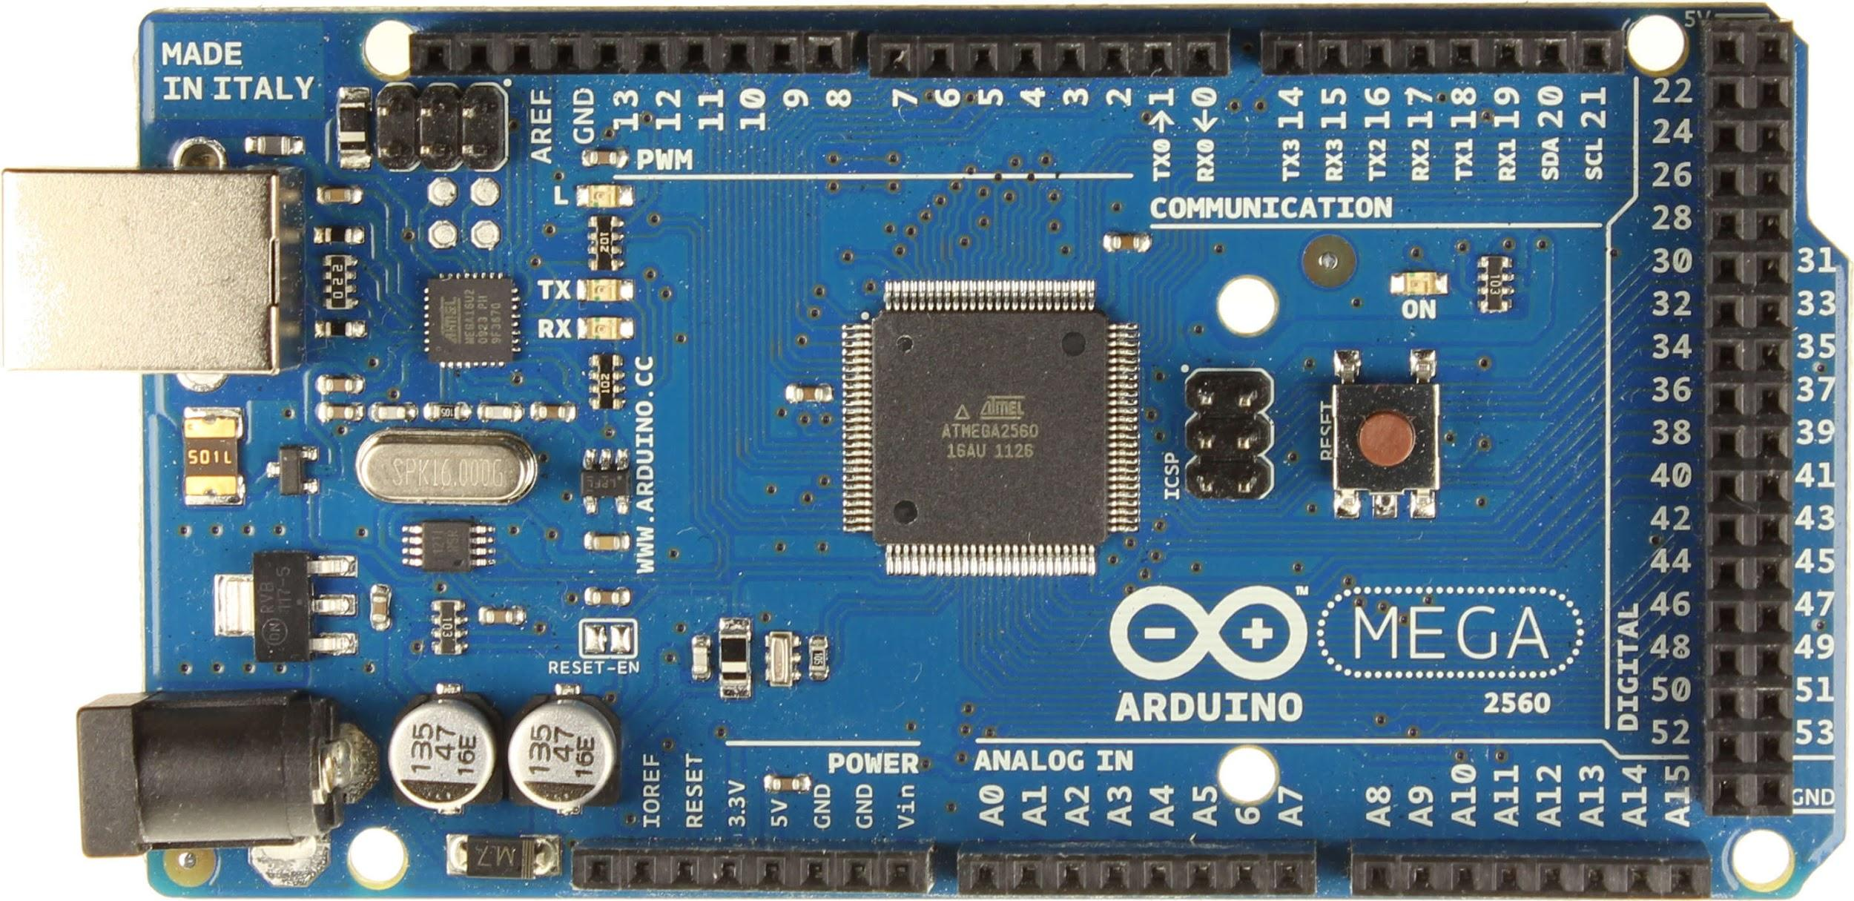
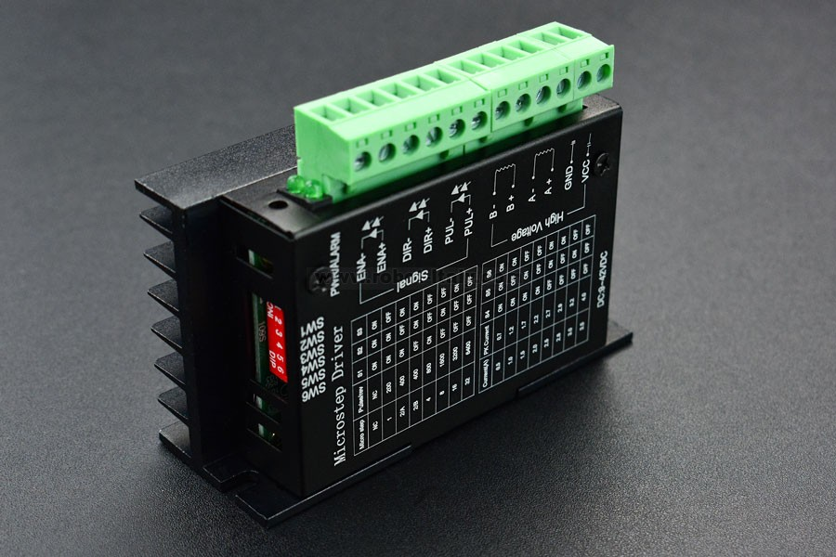
Powering and Controlling Our Device
Due to budget issues we were limited to an arduino and motor drivers to control our motors.
Using a code given online specifically for our motor drivers we were able to move our equipment.
The steps per revolution and speed in the code were arbitrarily set leaving it up to us to find our own way using trial and error
Our rotary moves at 6 rpm and our horizontal stage can move from one end to the other in 6 seconds
Figure 12: Arduino Mega 2560
Figure 13: DFRobot TB6600
Peters
POBA
Slide 12
Notes:
Capitalize the arduino. Project changed the scope late in the game. Turn into 2 slides

Slide 13
Test Performed on Our Device
Image Capture Test
Capture image(s) of the catheter balloon.
Inflation Test
Inflate catheter balloon using high and low pressures.
Check performance of air system
Rotation Test
Rotate catheter balloon and determine time it takes to complete 1 full revolution.
Movement Test
Move camera along horizontal stage.
Move camera along vertical stage.
Full Inspection Test
Time to to complete one full inspection.
Pooler
POBA
Slide 13
Notes:
Here are the test our team performed on our device. These test were done to individually inspect each subsystem before a full balloon inspection was done, and to see if our device meets all of our engineering requirements. We conducted an image capturing test to see if our device can view the catheter balloon, an inflation test to see if we can inflate a balloon and check the performance of the air system, a rotation test to see how fast the rotary system can complete 1 revolution, and a movement test to move the camera system along the horizontal stage and vertical stage.

Slide 14
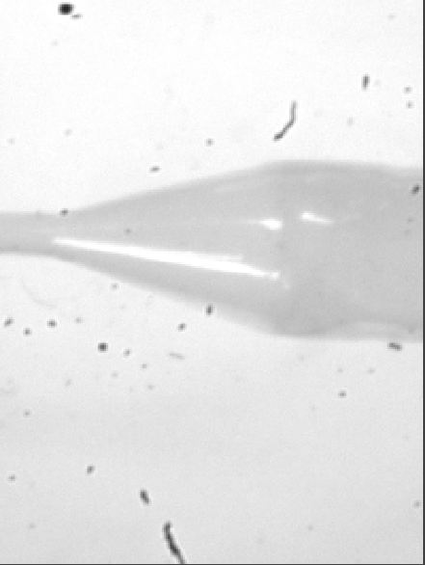
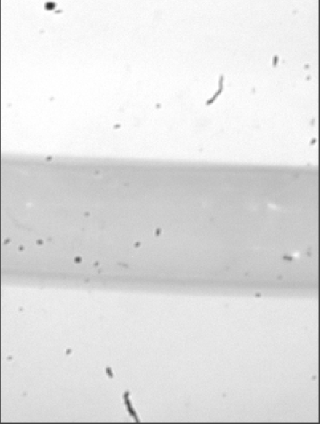
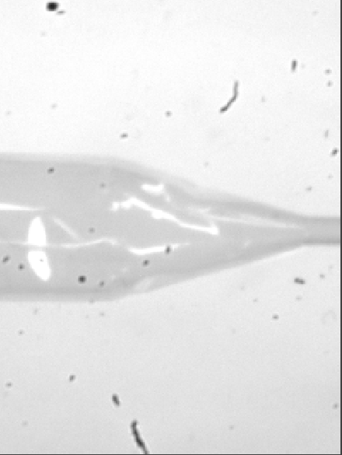
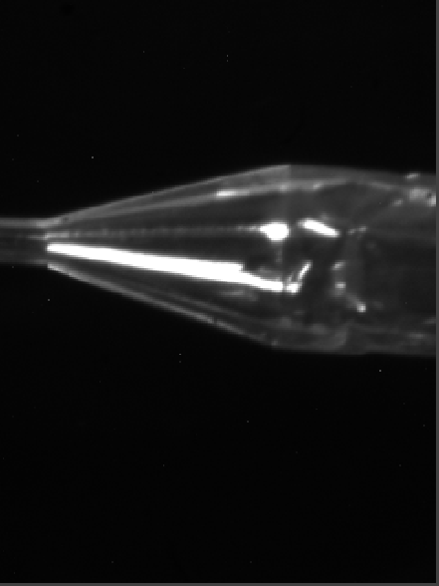
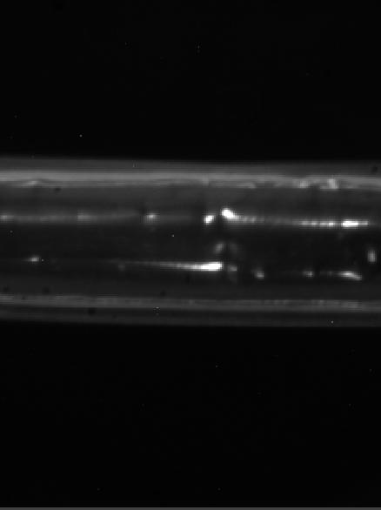
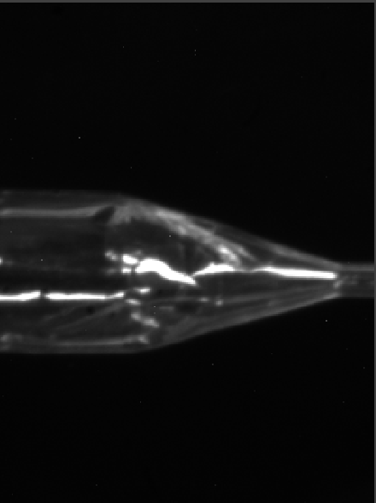
Test Results
Image Capture Test
Successful in capturing images of the catheter balloon.
Unsuccessful in capturing multiple images during one sequence.
Images produced using the camera’s software limits viewing options
Lens has particles within that effect images.
Figure 14-Images taken using backlight
Figure 15-Images taken using black background
Pooler
POBA
Slide 14

Slide 15
Test Results
Inflation Test
Semi-Successfully inflated catheter balloon.
The air entering the catheter balloon was lower than device input pressure.
Leaks in air-system.
Rotation Test
Rotary system rotates 360° in 8 seconds.
With current code we are unable to simultaneously rotate both rotary stages.
Movement Test
Horizontal stage and vertical stage successfully moves camera (length moved and speed determined by code) .
Full Inspection Test
Completed in 40 seconds.
Pooler
POBA
Slide 15

Slide 16
In Conclusion
The state of the art model (Interface Auto i-360) costs roughly $70,000.
What we have created costs around $11,000, with another $10,000 this machine can be completed and the customer will have a machine that costs less and does more than the Auto i-360.
Table 3- Engineering requirements and testing results.
Engineering Requirements | Target | Design Testing Results
Measure Balloon Length | 50-325 mm | 50-400 mm
Measure Balloon Diameter | 1.25-50 mm | 1.25-17 mm
Inflate Balloon | N/A | Semi-Successful
Rotational Movement | 180° | 360°
Longitudinal Movement | N/A | Successful
Inspection Time | 1 minute or less | Less than 40 seconds
Peters
POBA
Slide 16

Slide 17
Future Improvements
How much it will cost to finish project?
We estimate between other parts and services that it will cost roughly another $10k-12k.
What are the other parts that are needed to finish the machine?
Motion controller
Rest of air system (air booster, air tank, actuated control valves)
Custom programing
What will the machine be able to do once it is finished?
Measure the dimensions of the balloon (cone, overall dia., total length)
Detect defects in the balloons
Test Balloons at a “nominal” and “Burst” pressure
Provide a spreadsheet detailing balloon dimensions and pass/fail verification
Stevenson
POBA
Slide 17
Notes:
Burst meaning can the balloon handle a higher pressure to test its durability

Slide 18
Questions?

